Slide 1

PLANT LEAF DISEASE DITECTOR
HANNA
MES24MCA-2018
Department of Computer Applications
MES College of Engineering, Kuttippuram
21/08/2025

Slide 2
PRODUCT OWNER GEEVAR C ZACKARIAS ASSISTANT PROFESSOR DEPARTMENT OF COMPUTER APPLICATIONS MES COLLEGE OF ENGINEERING, KUTTIPPURAM

Slide 3
TABLE OF CONTENTS
Introduction
Motivation
Objective
Existing System
Proposed System
Functionalities
Module Description
Developing Environment
Sprint Backlog
Product Backlog
User Story
Project Plans

Slide 4
PLANT LEAF DISEASE DITECTOR
Plant diseases cause over 220 billion in global crop losses annually
Early detection enables targeted intervention and reduces pesticide use
Agricultural solution using Convolutional Neural Network (CNN) architecture for automated plant disease diagnosis
Real-time inference capability providing disease identification within seconds with confidence scores and treatment recommendations
Web-based application built with Flask framework enabling farmers to upload leaf images and receive instant disease predictions

Slide 5
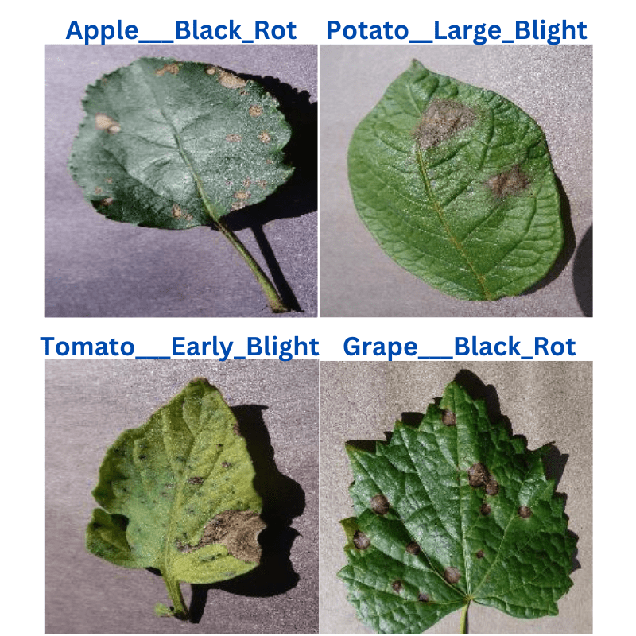
PLANT LEAF DISEASE DITECTOR
Images from the PlantVillage disease recognition dataset:

Slide 6
MOTIVATION
Agricultural productivity crisis with crop diseases causing 20-40% annual yield losses globally affecting food security
Limited access to plant pathologists in rural areas creating diagnostic gaps for millions of small-scale farmers
Economic impact of crop diseases costing billions annually due to delayed or incorrect diagnosis and treatment
Technology accessibility gap requiring user-friendly AI solutions that bridge advanced technology with practical farming needs
Sustainability goals promoting reduced pesticide use through accurate disease identification
Educational opportunity to demonstrate practical applications of deep learning in agricultural problem-solving

Slide 7
OBJECTIVES
Develop an automated plant disease detection system using CNN architecture to identify diseases from leaf images
Create a user-friendly web interface using Flask framework for easy image upload and result visualization
Achieve high accuracy performance in disease classification across multiple plant species and disease types
Implement real-time inference capability for practical agricultural use
Ensure scalable deployment suitable for web applications
Support multiple image formats (JPG, PNG, JPEG) with automatic preprocessing and validation

Slide 8
EXISTING SYSTEM
Manual disease identification by agricultural experts requiring physical field visits and extensive experience
Time-consuming diagnostic process taking days or weeks for accurate disease identification and treatment recommendations
Limited expert availability in rural areas leading to delayed diagnosis and potential crop loss
Subjective visual assessment prone to human error and inconsistent diagnoses between different experts
High consultation costs making professional diagnosis economically unfeasible for small-scale farmers

Slide 9
PROPOSED SYSTEM
Automated diagnosis using CNN deep learning model for instant disease identification
Web-based Flask application providing accessibility for farmers across different locations and devices
Real-time image processing with preprocessing pipelines ensuring consistent input format for optimal model performance
High-accuracy classification achieving accuracy on standard plant disease datasets with continuous improvement
Confidence scoring system providing reliability indicators for predictions to guide user decision-making

Slide 10
FUNCTIONALITIES
Image Upload & Processing: Drag-drop interface with real-time preview and validation
Disease Classification: 38-class prediction covering major crops and diseases
Multi-format Support: PNG, JPG, JPEG, GIF, BMP with 16MB maximum file size

Slide 11
MODULE DESCRIPTION
Data Preprocessing Module: Image resizing, normalization, and augmentation pipeline
Model Training Module: CNN model with transfer learning and fine-tuning
Inference Engine: Optimized prediction pipeline with preprocessing and postprocessing
Web Interface Module: Flask-based frontend with Bootstrap responsive design

Slide 12
DEVELOPING ENVIRONMENT
Operating System: Windows 11
Programming Language: Python 3.9+
Deep Learning Framework: TensorFlow 2.10+, Keras
Web Framework: Flask 2.3+
Frontend Technologies: HTML5, CSS3, JavaScript, Bootstrap 5
Development IDE: Visual Studio Code
Model Training Platform: Google Colab
Image Processing: OpenCV, PIL (Pillow)
Version Control: Git, GitHub

Slide 13
SPRINT BACKLOG
Backlog tem | Completion Date | Original Estimation in Hours | Day 1 hrs | Day 2 hrs | Day 3 hrs | Day 4 hrs | Day 5 hrs | Day 6 hrs | Day 7 hrs | Day 8 hrs | Day 9 hrs | Day 10 hrs
SPRINT1
Research & Planning | 15/08/2025 | 8 | 2 | 2 | 2 | 2 | 0 | 0 | 0 | 0 | 0 | 0
Data Collection | 22/08/2025 | 4 | 1 | 1 | 1 | 1 | 0 | 0 | 0 | 0 | 0 | 0
Data Preprocessing | 25/08/2025 | 6 | 1 | 1 | 2 | 2 | 0 | 0 | 0 | 0 | 0 | 0
SPRINT 2
Model Development | 02/09/2025 | 12 | 2 | 2 | 2 | 2 | 2 | 2 | 0 | 0 | 0 | 0
Model Fine Tuning | 08/09/2025 | 8 | 2 | 2 | 2 | 2 | 0 | 0 | 0 | 0 | 0 | 0

Slide 14
SPRINT BACKLOG
Backlog tem | Completion Date | Original Estimation in Hours | Day 1 hrs | Day 2 hrs | Day 3 hrs | Day 4 hrs | Day 5 hrs | Day 6 hrs | Day 7 hrs | Day 8 hrs | Day 9 hrs | Day 10 hrs
SPRINT3
Model Evaluation | 15/09/2025 | 10 | 2 | 2 | 2 | 2 | 1 | 1 | 0 | 0 | 0 | 0
Web Development | 20/09/2025 | 6 | 1 | 1 | 2 | 2 | 0 | 0 | 0 | 0 | 0 | 0
SPRINT 4
Testing & Debugging | 01/10/2025 | 14 | 2 | 2 | 2 | 2 | 2 | 2 | 2 | 0 | 0 | 0
Documentation | 08/10/2025 | 8 | 2 | 2 | 2 | 2 | 0 | 0 | 0 | 0 | 0 | 0
TOTAL |  | 76 | 15 | 15 | 19 | 19 | 5 | 5 | 2

Slide 15
PRODUCT BACKLOG
ID | NAME | PRIORITY <high/medium/ low> | ESTIMATE (Hours) | STATUS <Planned/In progress/Completed>
1 | Project Setup & Environment | High | 12 | Completed
2 | Dataset Collection & Preprocessing | High | 15 | In Progress
3 | CNN Model Development | High | 20 | Planned
4 | Flask Backend Development | High | 18 | Planned

Slide 16
PRODUCT BACKLOG
ID | NAME | PRIORITY <high/medium/low> | ESTIMATE (Hours) | STATUS <Planned/In progress/Completed>
5 | Frontend User Interface | Medium | 8 | Planned
6 | Image Upload & Processing Module | High | 6 | Planned
7 | Model Integration & Testing | High | 10 | Planned
8 | Performance Optimization | High | 8 | Planned
9 | Documentation & Deployment | Low | 12 | Planned

Slide 17
USER STORY
User Story ID | As a type of User | I want to <Perform some task> | So that i can <Achieve Some Goal>
1 | FARMER | Upload plant leaf images | Get instant disease diagnosis for my crops
2 | FARMER | View prediction results | Understand what disease affects my plants
3 | FARMER | Access the system on website | Use the application while working anywhere
4 | RESEARCHER | Register | Understand the CNN implementation details
5 | EXTENSION OFFICER | Use the diagnostic tool | Assist farmers with professional plant health advice

Slide 18
PROJECT PLAN
User StoryID | Task Name | Start Date | End Date | Days | Status
1 | SPRINT 1 | 09/08/2025 | 15/08/2025 | 16 | Completed
2 |  | 17/08/2025 | 22/08/2025 |  | Planned
3 |  | 23/08/2025 | 25/08/2025 |  | Planned
1 | SPRINT 2 | 27/08/2025 | 02/09/2025 | 13 | Planned
3 |  | 03/09/2025 | 08/09/2025 |  | Planned

Slide 19
PROJECT PLAN
User StoryID | Task Name | Start Date | End Date | Days | Status
3 | SPRINT 3 | 10/09/2025 | 15/09/2025 | 11 | Planned
4 |  | 16/09/2025 | 20/09/2025 |  | Planned
4 | SPRINT 4 | 21/09/2025 | 01/10/2025 | 16 | Planned
5 |  | 03/10/2025 | 08/10/2025 |  | Planned

Slide 20
THANK YOU

